Slide 1

Project 2: Fire in the nature park Intelligent Data Analysis & Machine Learning I
Jaesub Kim
University of Potsdam
M. Sc. Bioinformatics
07. 08. 2024

Slide 2
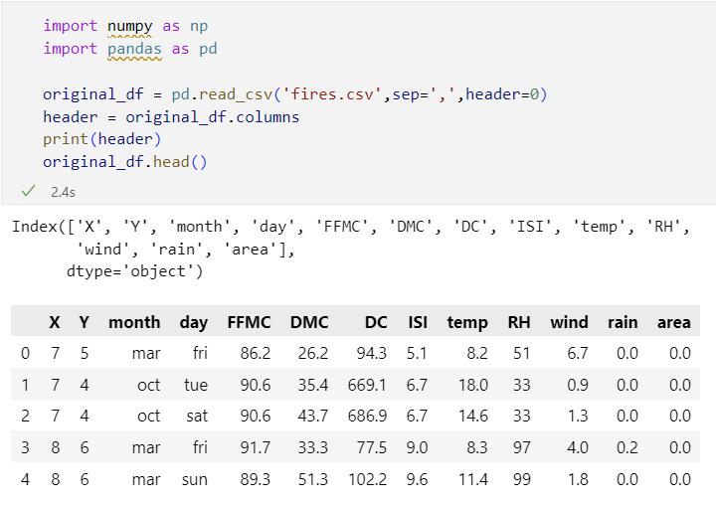
Data Preperation
Fire data: 13 Features
Two categorical features: ‘month’ and ‘day’
Objective: prediction of the brunt forest ‘area’

Slide 3
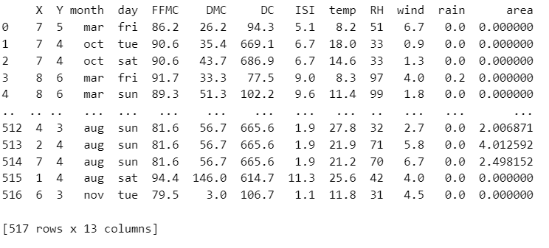
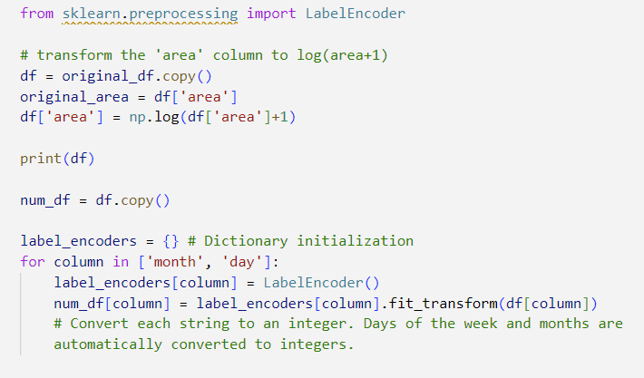
Data Preprocessing
Log-transformation of feature ‘area’
Two categorical features are transformed to integer for further process
`LabelEncoder()` maps an unique integer value to categorical value

Slide 4
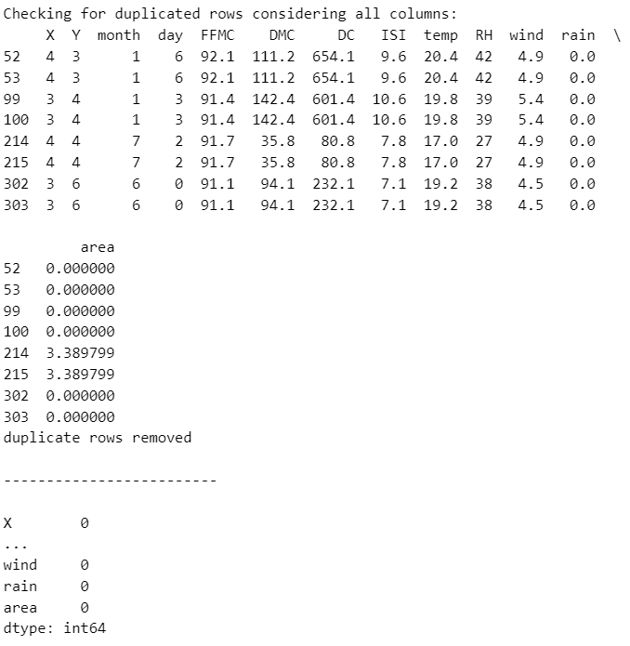
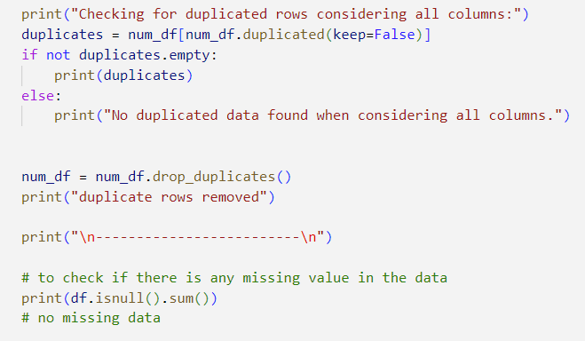
Data Preprocessing
Check if there are any missing values
Check if there are any duplicated values
No missing values
Duplicated values are removed

Slide 5
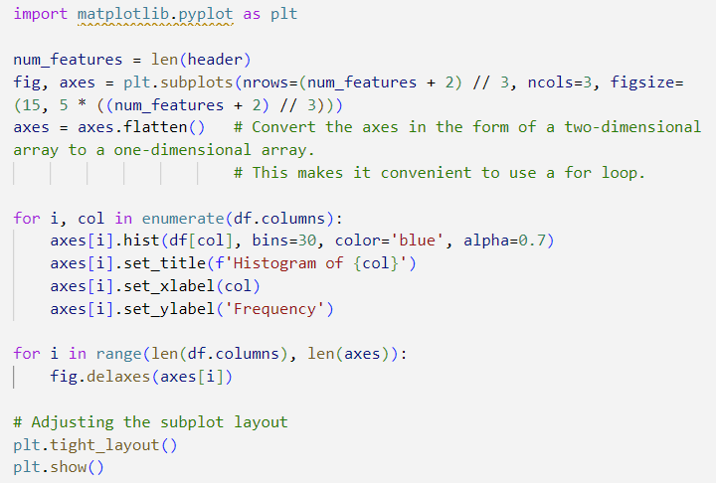
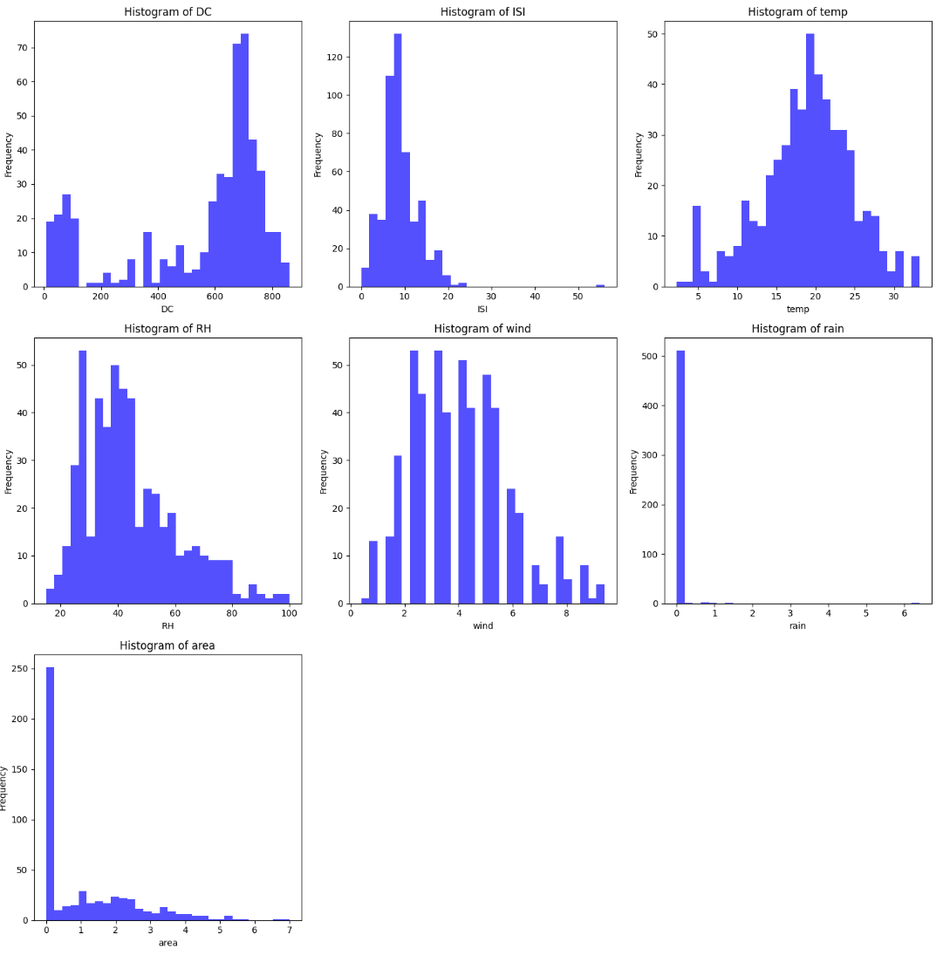
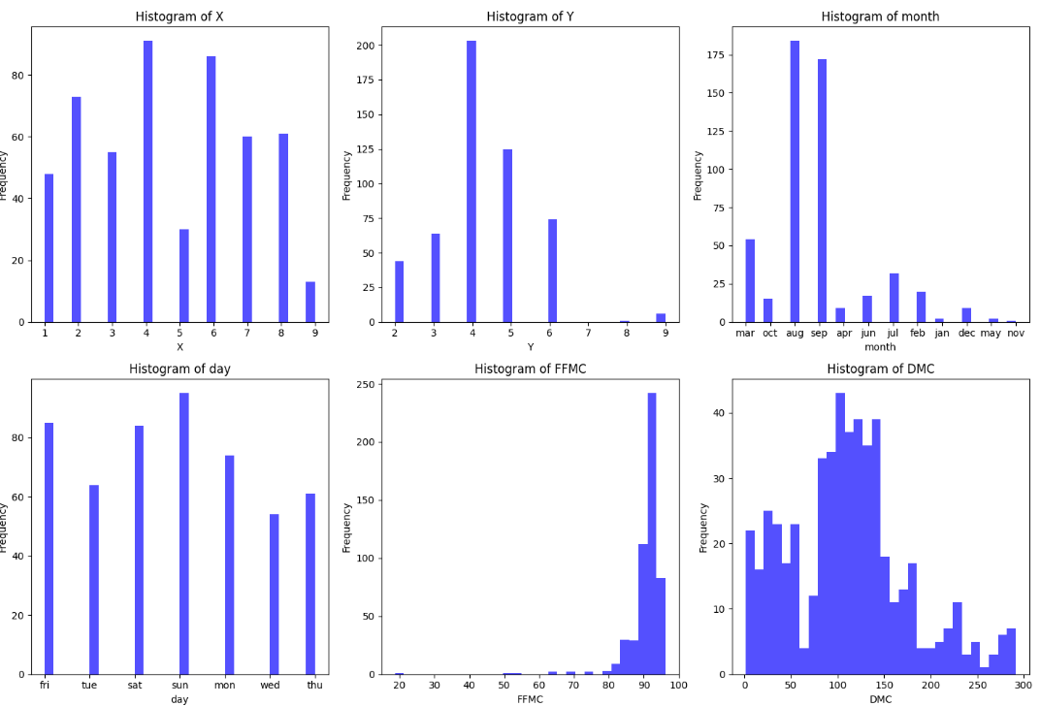
Data Analysis
Histogram representation using pyplot library

Slide 6
Data Analysis
Histogram representation using pyplot library

Slide 7
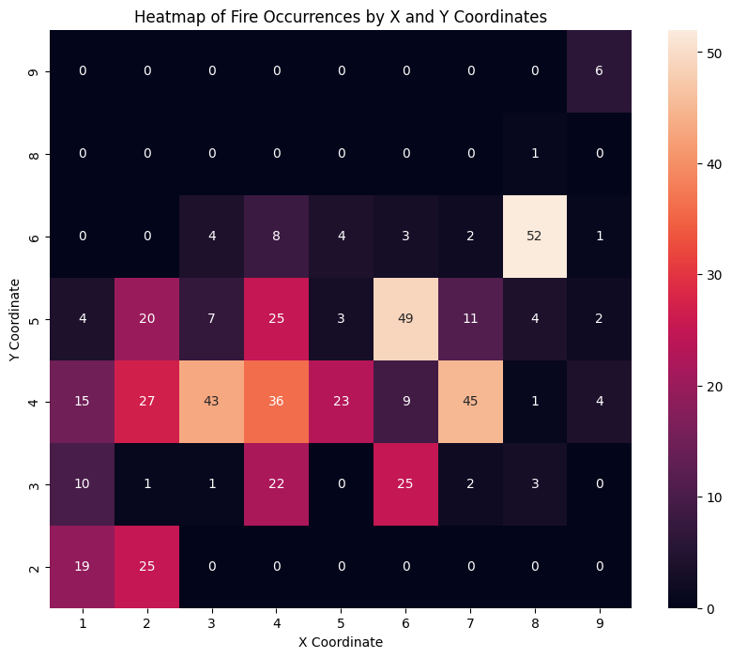
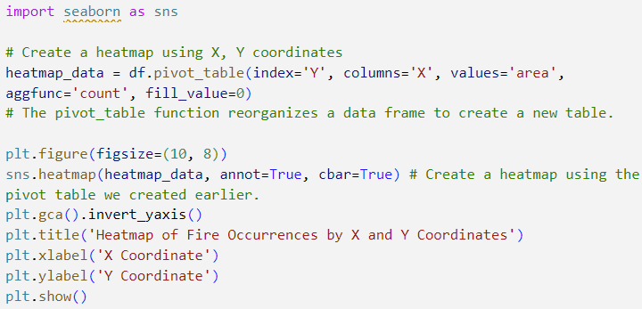
Data Analysis
Find relationship between coordinate and fire occurrences: location specificity
The most frequent fires occur in (8,6), (6,5), (7,4), and (3,4) (n>40).
Problem: most of value of 'area' are very low
There might not be a relationship between location and ‘area’

Slide 8
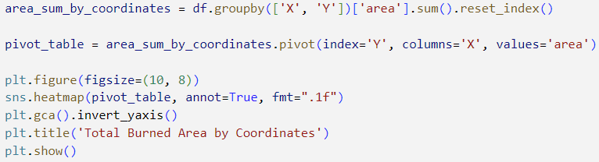
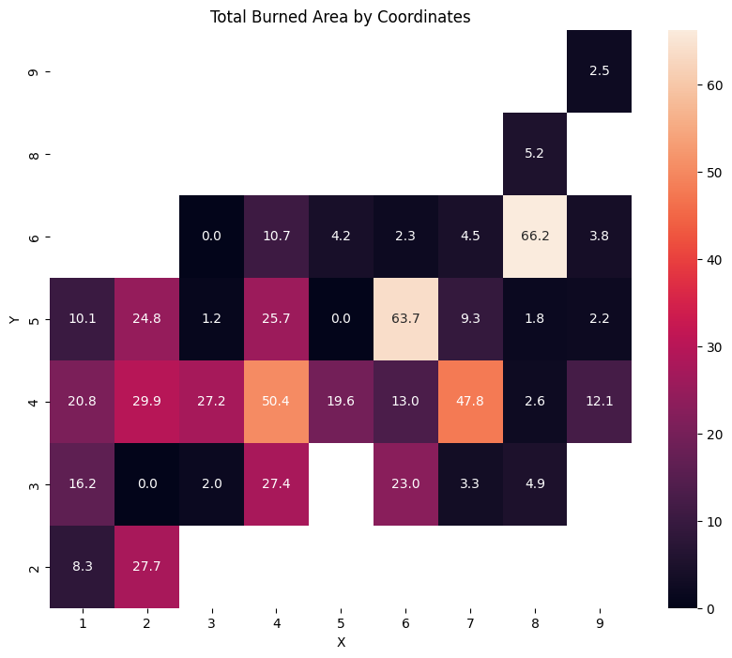
Data Analysis
There seems to be a correlation between occurrence and sum of ‘area’, but low

Slide 9
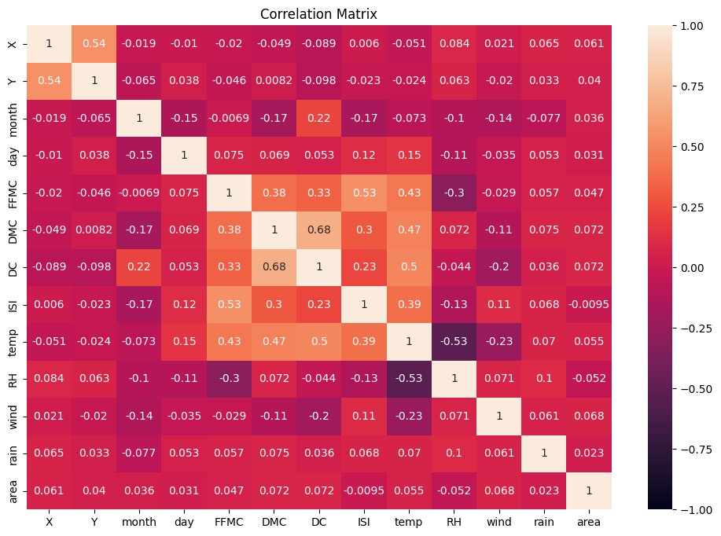
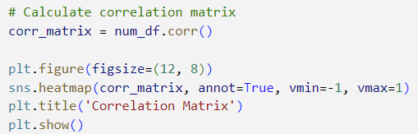
Data Analysis
DMC and DC show the highest correlations
These two show a relatively low correlation with FFMC
Temperature has a strong correlation with these three features, and RH

Slide 10
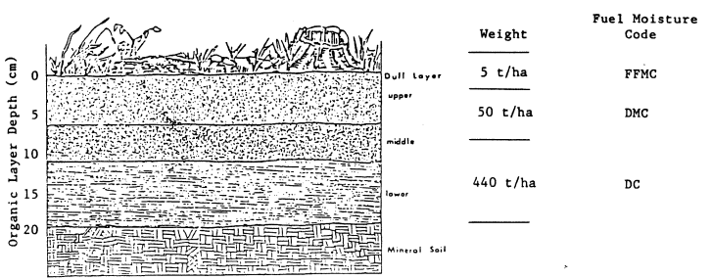
Data Analysis
DMC and DC show the highest correlations
These two show a relatively low correlation with FFMC
Temperature has a strong correlation with these three features, and RH

Slide 11
Model Selection
Random Forest
Linear Regression, Decision Tree, SVM, etc.. Many options
Our data have only 13 features -> no reason to use SVM
Our data set is small: only ca. 500 size
Decision Tree has a higher risk of overfitting than Random Forest
Stojanova et al. (2012) compared and evaluated models such as KNN, DT, LR and SVM for prediction of forest fires
RF showed the highest performance

Slide 12
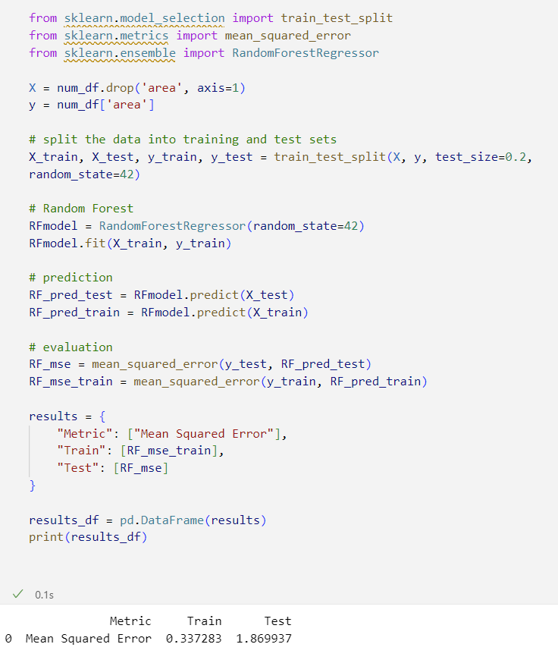
Random Forest
A large difference in MSE between the training set and the test set
It might be caused by overfitting!

Slide 13
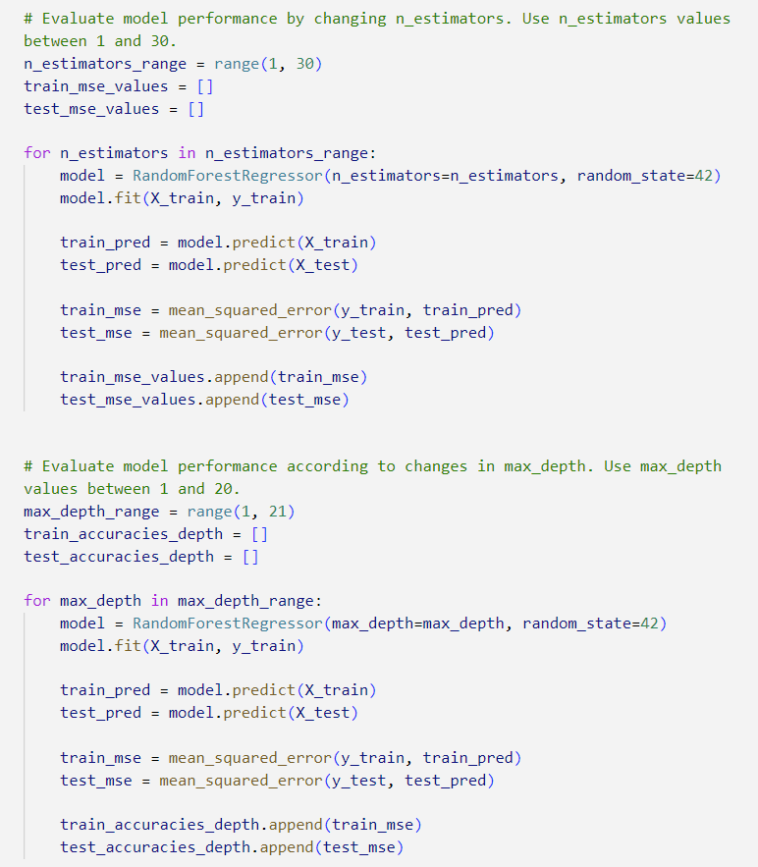
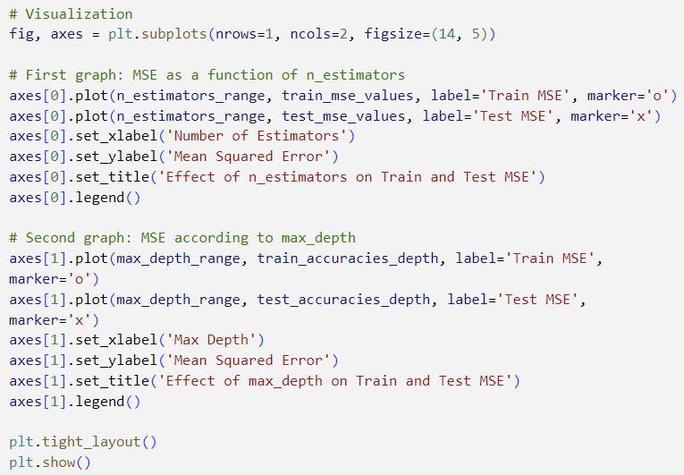
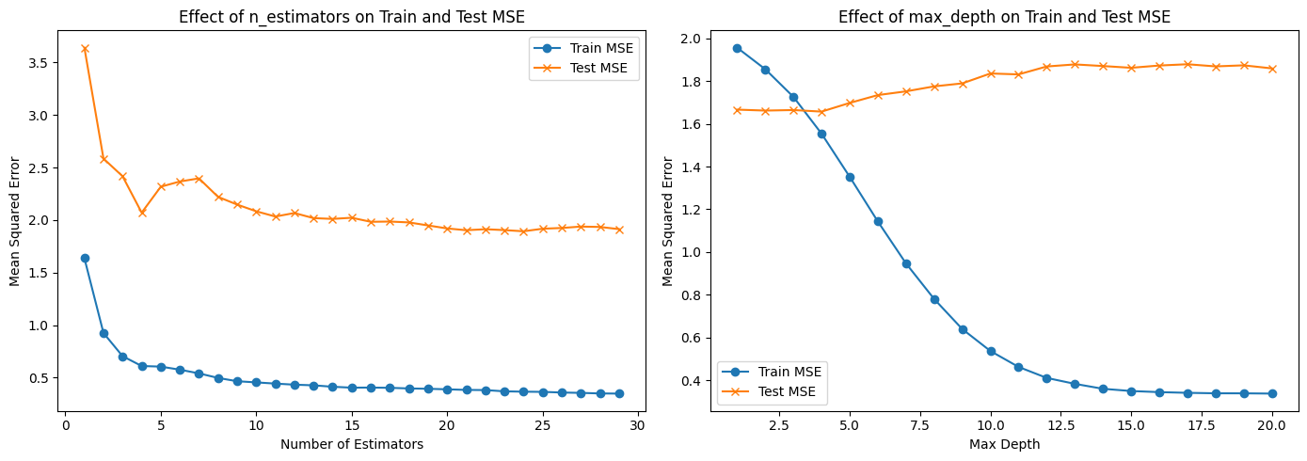
Parameter modification

Slide 14
Parameter modification

Slide 15
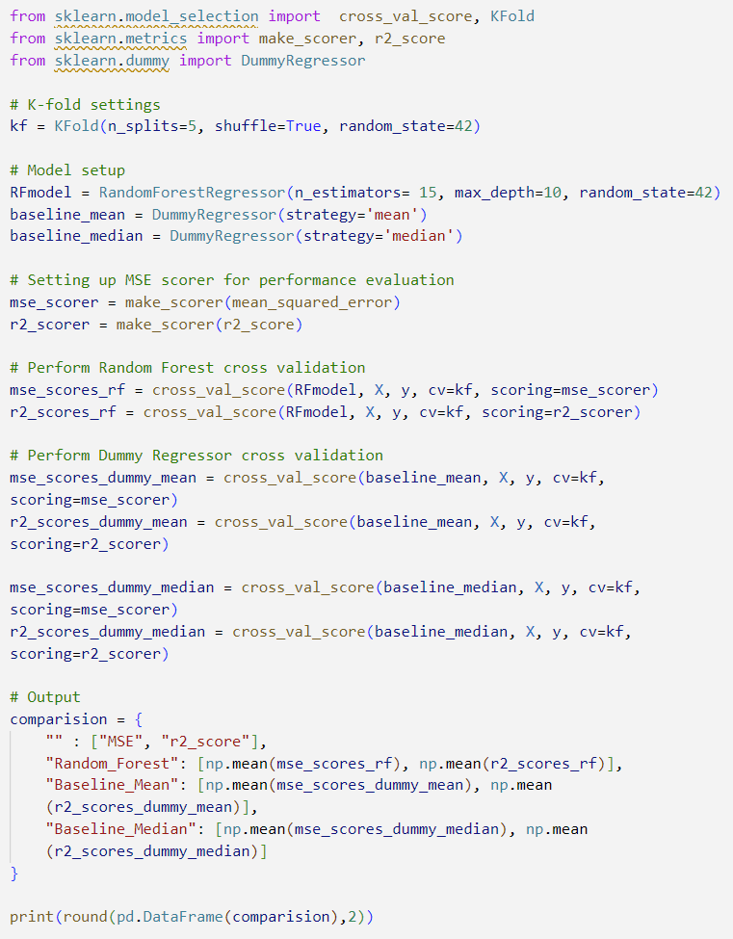

Evaluation
Baseline Model: Dummy Regressor for prediction of mean and median
Evaluation using MSE and r2 score
MSE(RF) < MSE(dummy_mean) & negative r2 score
Our model doesn’t showing good performance

Slide 16
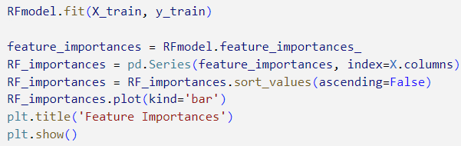
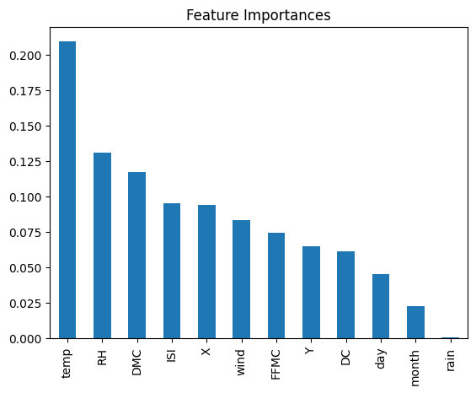
Feature Importances
The 3 most important role in prediction were `temp`, `RH`, and `DMC`
Remarkable contribution of `temp`
It is assumed to be due to high correlation with other important features.
Very low contribution of month and rain
Most of the data is distributed in a narrow range
Does not play a significant role in prediction

Slide 17
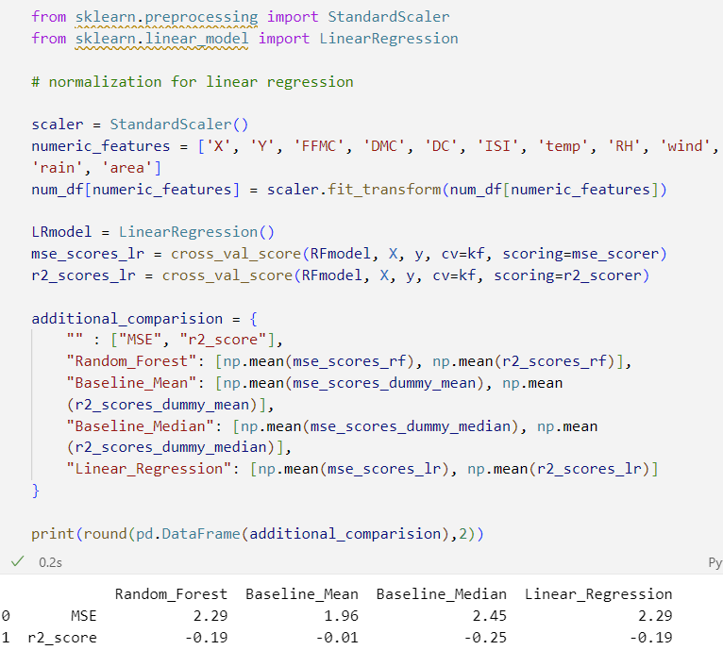
Additional Analysis
In case our RF model does not fit the data well, Linear regression is also tested
For Linear Regression, normalization is needed
Here, z-score normalization is used
It shows exactly same bad performance

Slide 18


